Slide 1

NUTRITION PHYSICAL ACTIVITY AND OBESITY BEHAVIORAL RISK FACTOR SURVELLIANCE SYSTEM
Group -03
Akhil Venkatesh Amboori
Varsha Alle
Varshitha Velkanti
UNIVERSITY OF NORTH TEXAS
ADTA 5940
Dr. Denise Philpot
Spring 2024

Slide 2

Introduction
To preserve lives, there are a few divisions that focus on the analysis of the prior health difficulties. DNPAO, or the component of Nutrition, Physical Activity, and Obesity, is a component of the US Centers for Disease Control and Prevention (CDC).
The objectives of DNPAO are to reduce obesity, increase physical activity, improve nutrition, and achieve health equity by reducing disparities. In terms of health status or access to care, there are differences between different geographic, racial, ethnic, and socioeconomic groups.

Slide 3
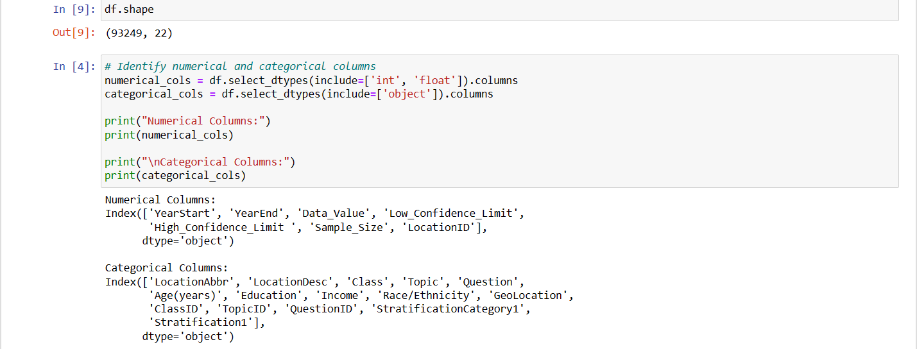
About the dataset
The dataset contains 93249 rows and 22 columns.
It has 7 numerical columns and 15 categorical columns.
The data is collected from the Behavioral Risk Factor Surveillance System which is a nationwide survey conducted annually.

Slide 4
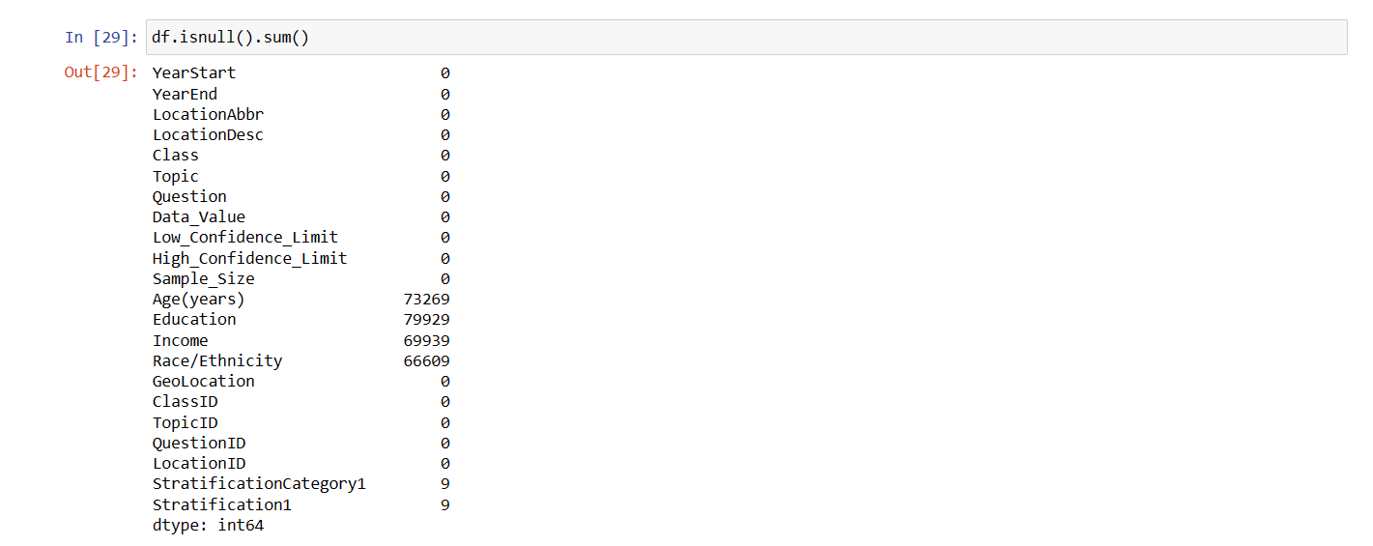
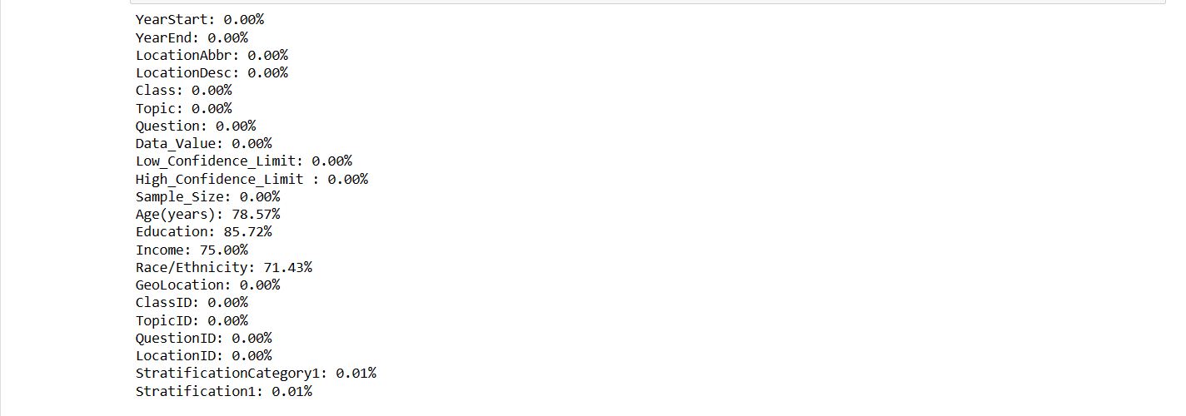
Data Cleaning
As part of data cleaning, we have checked if there are any null values in the dataset. We have set criteria to remove attributes with null values that had null value percentage above 50%. We found that the following attributes have the respective null values percentages,
Age(years): 78.57% Education: 85.72%, Income: 75.00% Race/Ethnicity: 71.43%. We have then dropped these attributes as they do not contribute much to our analysis. We also removed records that had missing values. The resultant dataset consists of 93240 rows and 18 columns.

Slide 5

Research Questions
How has the prevalence of obesity changed over the years covered?
Are there significant differences in obesity rates between different geographic locations?
Can the questions be categorized into different topics or themes (e.g., diet, exercise, weight management, health conditions, etc.)?
How does the sample size ('Sample_Size') affect the reliability and generalizability of the reported health behavior estimates?

Slide 6

Exploratory Data Analysis

Slide 7
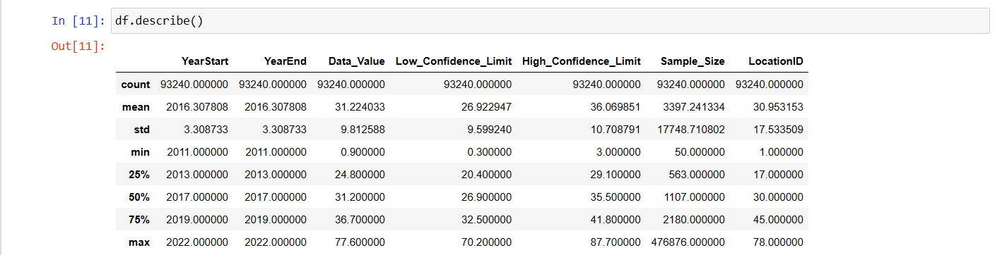
Descriptive Statistics
Most observations in the cleaned dataset are centered around the mean and median years of 2016 and 2017, respectively. The dataset spans a range of years from 2011 to 2022.
With an average of 31.22% and a standard deviation of 9.81, the Data_Value column, which probably reflects the primary statistic or measure under analysis, indicates a broad range of values across many observations.
In terms of Data_Value, the lower and upper percentiles are 24.8 and 36.7, respectively, meaning that half of the observations are in this range. With typical values of 26.92 and 36.07, respectively, the Low_Confidence_Limit and High_Confidence_Limit columns give the lowest and highest limits of the confidence interval for the Data_Value statistic.

Slide 8
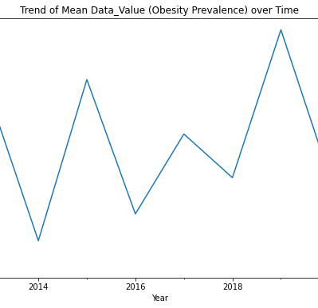
Trend of Mean Data_Value (Obesity Prevalence) over Time
The line chart displays the 'Data_Value' (probably corresponding to a health-related action or result) for the years 2011 through 2022.
According to the pattern's analysis, there is an annual trend in which the 'Data_Value' fluctuates between greater and smaller values on an annual basis, roughly between 29% and 33%.
The 'Data_Value' appears to have been quite consistent in the past few years (2020–2022), varying between 30 and 31%.
2019 saw the greatest value at 32.639698, while 2014 saw the lowest value at 29.525000.

Slide 9
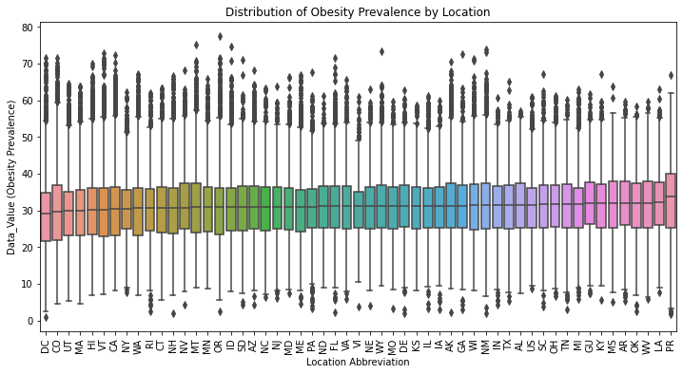
Distribution of Obesity Prevalence by Location
The box plot illustrates the median rates of obesity prevalent in various states, with values that range from approximately 29% in DC, CO, and UT to approximately 33.8% in PR. The plot also showed a substantial number of outliers on the upper quartile for all locations, with obesity prevalence estimates as high as 80%. The US as a whole has a median rate of obesity of 31.6%, however, states vary greatly in this regard; some have relatively low rates (such as MA, HI, and VT) and others have comparatively high rates (like AR, OK, and MS). Significantly greater obesity rates may be caused by certain demographic groupings, socioeconomic difficulties, or other fundamental reasons, as suggested by the existence of outliers on the upper end of the distribution.

Slide 10
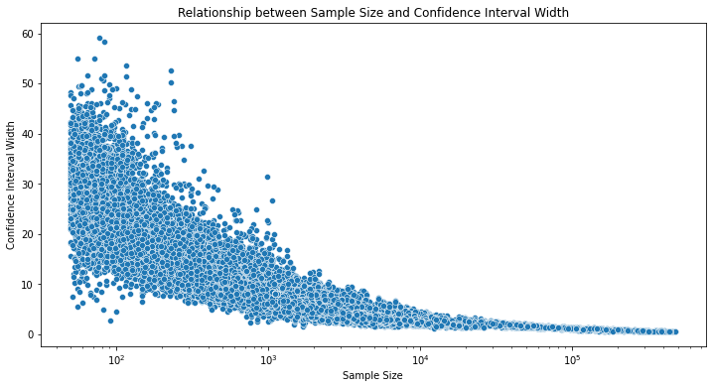
Relationship between Sample Size and Confidence Interval Width
The scatter plot demonstrates the inverse relationship between sample size and confidence interval (CI) width, wherein bigger sample sizes yield more accurate predictions and smaller CI width ranges, signifying decreased ambiguity and increased confidence in the estimations. The CI width for a sample size of 100 spans from 0 to 60, suggesting a comparatively high degree of ambiguity. The range narrows to 0 to 30 when the study size grows to 1000, lowering the level of uncertainty but maintaining a sizable range of potential CI widths. The range progressively decreases to 0 to 10 with a sample size of 10,000, greatly lowering the uncertainty and producing more accurate estimations. Finally, the range of values of CI width is smallest for a sample size that is exceedingly large of 100,000, ranging from 0 to 5, showing minimal ambiguity and continuously tiny CI widths. Larger sample sizes typically result in more accurate estimates, but the CI width can also be affected by other variables like data fluctuation, the fundamental distribution, and the confidence level selected.

Slide 11
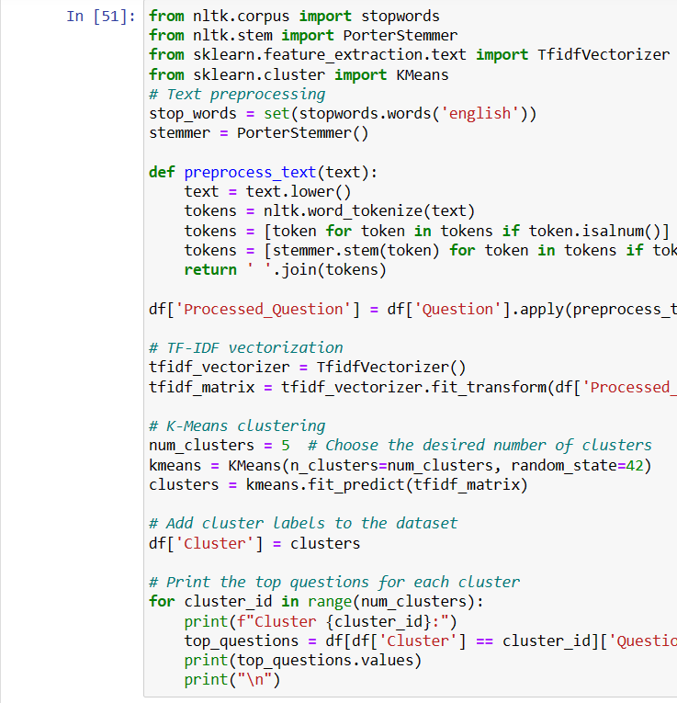
Categorization of questions into different clusters based on various themes
The available clusters can be divided into three primary themes: Diet/Nutrition (Cluster 2), Weight Management (Clusters 1 and 4), and Exercise/Physical Activity (Clusters 0 and 3). Metrics of aerobic and muscle-strengthening activities are the emphasis of Cluster 0, whereas passive lifestyles and inadequate levels of leisure-time physical activity are covered by Cluster 3. Clusters 1 and 4 pertain to the proportion of adult population classified as overweight or obese, according to their body mass index (BMI). Measures about fruit and vegetable consumption are included in Cluster 2, as this is a good indication of dietary practices and nutrient intake. These themes are closely related and have a significant impact on one's general health and well-being because they address vital topics including eating habits, weight control, and physical activity levels.

Slide 12

Data Preprocessing

Slide 13
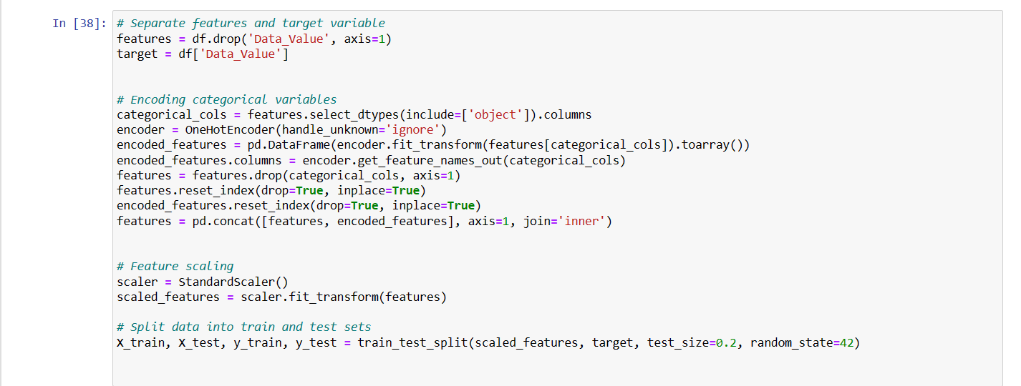
As part of data pre-processing, first we performed the separation of the features and the target variable from the dataset.
Secondly, we performed one-hot encoding on the categorical attributes to convert them into binary columns.
We also performed scaling on the features to improve the performance of the models.
Eventually, we performed the splitting of the cleaned dataset into training and test datasets. This allows us to train a certain portion of the data and use the test data set to determine the model’s performance on the hidden patterns of data.

Slide 14
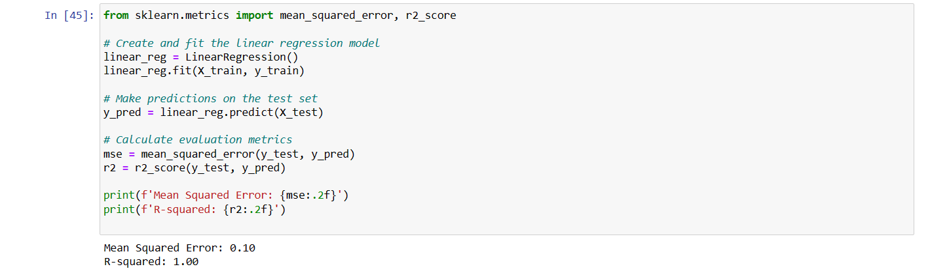
Linear Regression
The outcome that has been provided indicates that the linear regression model has an R-squared (R²) value of 1.00 and a Mean Squared Error (MSE) of 0.10. The forecasts made by the model are, on average, extremely close to the actual values, with a reasonably little error, as indicated by the low MSE. The ideal fit is indicated by the R2 value of 1.00, which indicates that the model can use the given features to explain 100% of the variance in the target variable. The correlation between the linear regression model's high R² and low MSE indicates that it is operating extraordinarily effectively on the provided dataset.

Slide 15
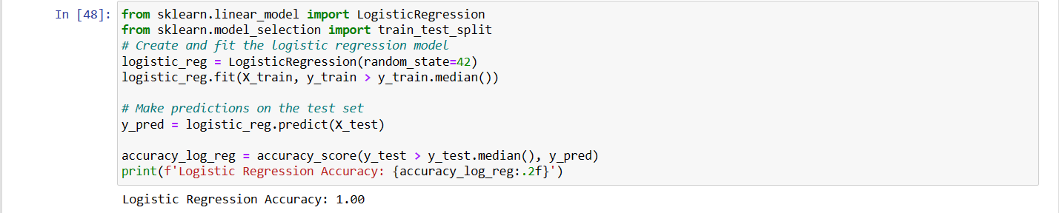
Logistic Regression
The Logistic Regression model performed exceptionally well, as evidenced by its accuracy of 1.0 (or 100%), which shows that it properly identified every instance in the test set based on the binarized target variable (i.e., whether the target value is above or below the median). This flawless accuracy score, however, can also be a sign of overfitting, in which the model has become overly adept at handling the noise and abnormalities present in the training set, which could result in subpar performance when dealing with fresh, untested data.

Slide 16
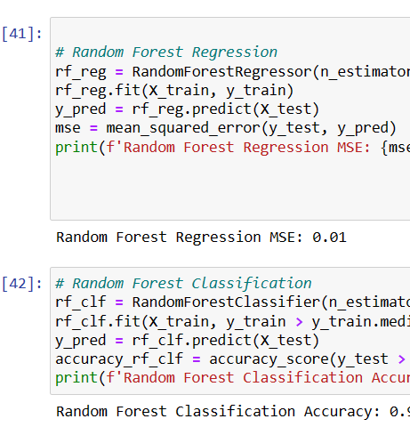
Random Forest Regression and Random Forest Classification
The Random Forest Classification model demonstrates an exceptional accuracy of 0.99 (or 99%), implying it accurately categorized 99% of the test set instances depending on the binarized target variable. The Random Forest Regression model accomplishes an exceptionally low Mean Squared Error (MSE) of 0.01 in the provided output, demonstrating that its forecasts are extremely similar to the actual values with little variance. These assessment indicators indicate that both models are operating at a very high level; the Random Forest Classification model is exhibiting outstanding effectiveness in categorizing instances based on the attributes provided, and the Random Forest Regression model is producing extremely precise forecasts for the continuous target variable.

Slide 17
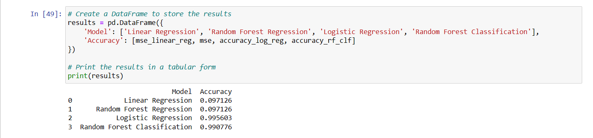
Results
All the four models have exceptional performance.
We can see that both logistic regression and Random Forest Classification have 99% accuracy indicating that both models accurately categorized the test set instances based on the target variable.
The linear regression and Random Forest Regression models both have very low MSE values of 0.09 indicating the accurate forecasting of instances similar to the actual values.

Slide 18
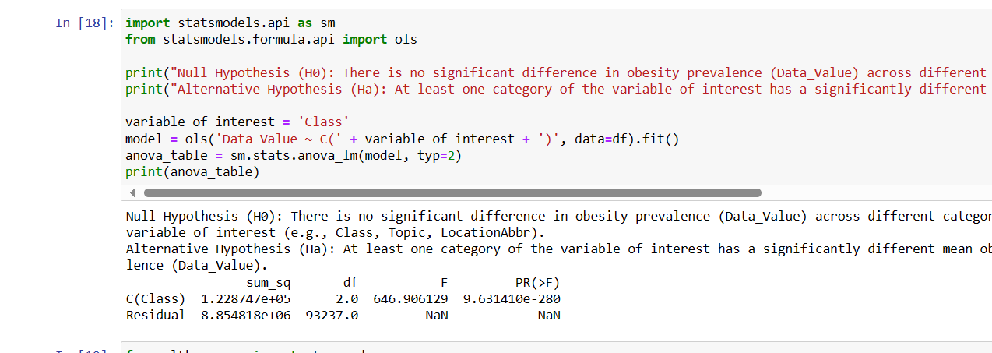
Hypothesis Testing
Null Hypothesis (H0): There is no significant difference in obesity prevalence (Data_Value) across different categories of the variable of interest (e.g., Class, Topic, LocationAbbr).
Alternative Hypothesis (Ha): At least one category of the variable of interest has a significantly different mean obesity prevalence (Data_Value).
Result: Based on the findings of the ANOVA, it is possible to reject the null hypothesis that there is no significant difference in the prevalence of obesity (Data_Value) between the different categories of the variable 'Class'. The alternative hypothesis is supported by the extremely small p-value (9.631410e-280) and the huge F-statistic (646.906129), which indicate that at least one 'Class' category has a significantly different mean obesity prevalence than the other categories.

Slide 19
Future Proposals
suggests including interaction terms in the logistic regression framework among predictor variables since meaningful interactions might shed light on the connections between the variables and the desired result.
suggests using regularization methods to solve any overfitting problems and enhance model generalization, such as L1 (Lasso) or L2 (Ridge) regularization.
Recommends using holdout validation along with cross-validation methods to provide a more thorough assessment of the model's resilience and effectiveness.

Slide 20

Conclusion
In summary, the dataset offers insightful information about the prevalence and trends of physical inactivity, obesity, and poor eating habits in the general population. To encourage better lives and lessen gaps in health care, the present research has highlighted important areas for specific action and formulation of policies by examining temporal patterns, regional disparities, and demographic variances.
As we move forward, it will be crucial to address the dataset's limitations through ongoing research projects like integrating data, long-term research, and volunteer programs. Through the use of an integrated strategy and the utilization of cutting-edge technologies like machine learning and geospatial analysis, we can enhance our comprehension of the multifaceted factors that impact wellness habits and provide guidance for proven strategies that enhance outcomes for public health.

Slide 21
References
Friligkos, G., Papaioannou, E., & Kaklamanis, C. (2023). A framework for applying the Logistic Regression model to obtain predictive analytics for tennis matches.
Baillot, A., Chenail, S., Barros Polita, N., Simoneau, M., Libourel, M., Nazon, E., ... & Romain, A. J. (2021). Physical activity motives, barriers, and preferences in people with obesity: A systematic review. PloS one, 16(6), e0253114.
Jennings, V., & Bamkole, O. (2019). The relationship between social cohesion and urban green space: An avenue for health promotion. International journal of environmental research and public health, 16(3), 452.
Oakman, J., Kinsman, N., Stuckey, R., Graham, M., & Weale, V. (2020). A rapid review of mental and physical health effects of working at home: how do we optimise health?. BMC public health, 20, 1-13.

